Slide 1

7th Grade Math
Unit 4, Lesson 8 Exploring the Area of a Circle Volume 1, pg. 162

Slide 2


Benchmark
MA.7.GR.1.4
Explore and apply a formula to find the area of a circle to solve mathematical and real-world problems.
volume 1, pg. 162

Slide 3
Integrated Mathematical Thinking and Reasoning Standards
MA.K12.MTR.1.1 Actively participate in effortful learning both individually and collectively.
MA.K12.MTR.2.1 Demonstrate understanding by representing problems in multiple ways.
MA.K12.MTR.4.1 Engage in discussions that reflect on the mathematical thinking of self and others.
MA.K12.MTR.5.1 Use patterns and structure to help understand and connect mathematical concepts.
volume 1, pg. 162

Slide 4

Learning Target
I can use the area of a rectangle to develop the formula for the area of a circle.
volume 1, pg. 162

Slide 5

Warm-Up
volume 1, pg. 163

Slide 6
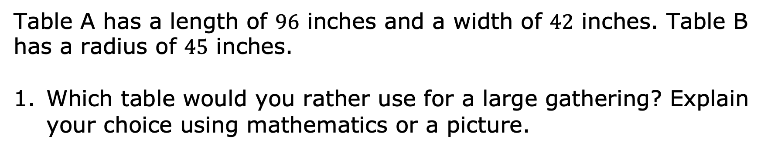
4.8.1 Warm-Up: Would You Rather?
Table A has a length of $96$ inches and a width of $42$ inches. Table B has a radius of $45$ inches.
Which table would you rather use for a large gathering? Explain your choice using mathematics or a picture.
volume 1, pg. 163
Notes:
Video Link: https://algebranation.wistia.com/medias/fi4fidi5y8

Slide 7

Guided Practice
volume 1, pg. 163

Slide 8
4.8.2 Guided Practice: Area of a Circle
A closed figure is an enclosed shape that occupies space. A circle is an example of a closed figure.
Draw a picture of a figure that is not closed.
volume 1, pg. 163

Slide 9

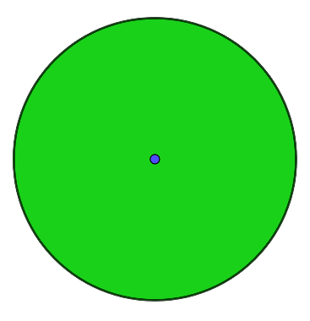
Area is the measure, in square units, of the inside region of a closed two-dimensional figure.
Discuss with your partner why a closed figure can have an area, but a figure that is open cannot have an area. Summarize your discussion.
The measure of the space inside the circle is the circle’s area.
Area
volume 1, pg. 163

Slide 10

Activity
volume 1, pg. 164

Slide 11

4.8.3 Activity: The Formula for the Area of a Circle
Your teacher will give you and your partners each a circle that is separated into four, eight, or sixteen sections.
Draw an image of your circle and your partners' circles in the first column of the table.
Cut out each of the sections of your circle.
Rearrange your sections, side by side, to compose a figure that resembles a parallelogram. Paste this in the last column.
Draw an image of both of your partners’ composed shapes in the last column.
volume 1, pg. 164

Slide 12
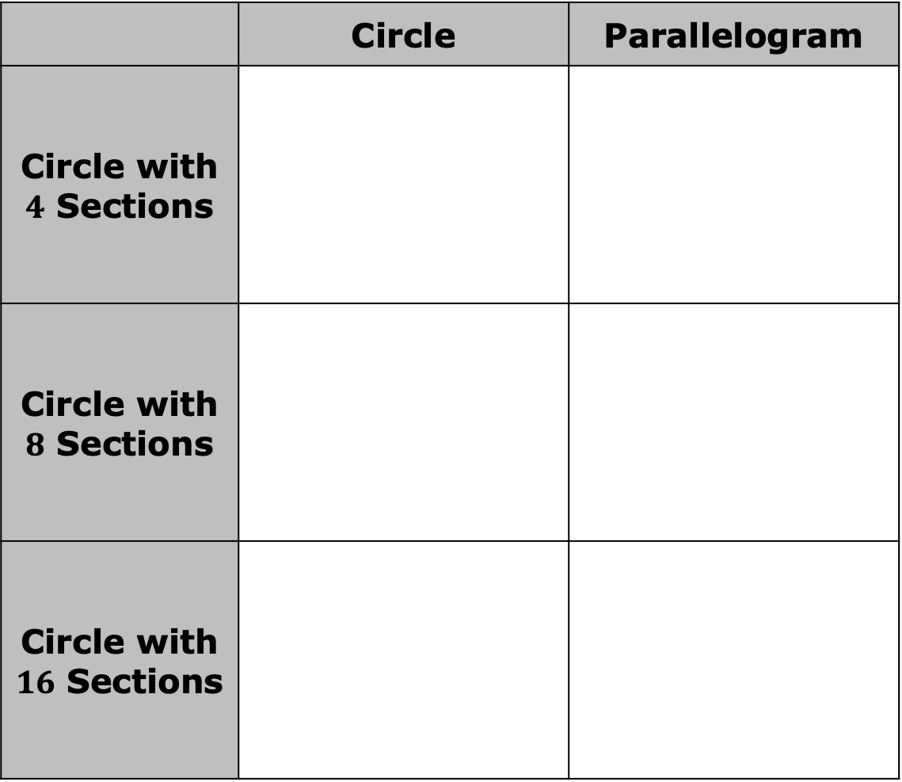
 | Circle | Parallelogram
Circle with $4$ Sections
Circle with $8$ Sections
Circle with $16$ Sections
volume 1, pg. 164

Slide 13
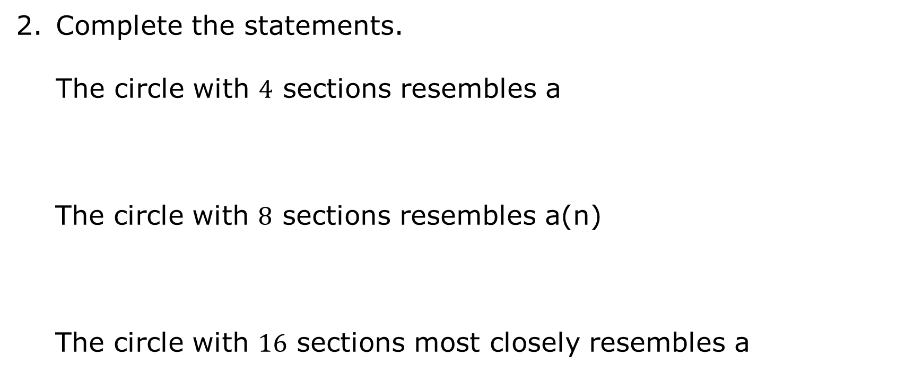
Complete the statements. The circle with $4$ sections resembles a
The circle with $8$ sections resembles a(n)
The circle with $16$ sections most closely resembles a
square.
parallelogram.
parallelogram.
octagon.
kite.
square.
rectangle.
volume 1, pg. 164

Slide 14
Discuss with your partners what shape you will see if the number of sectors continues to increase. Summarize your discussion.
volume 1, pg. 164

Slide 15
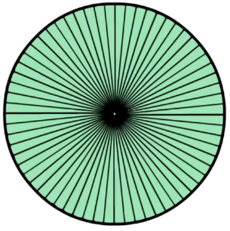
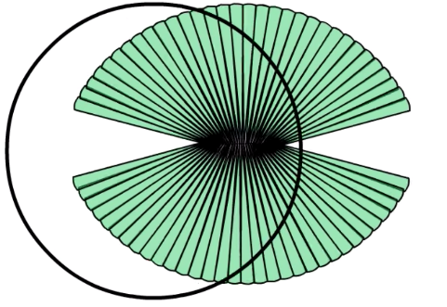
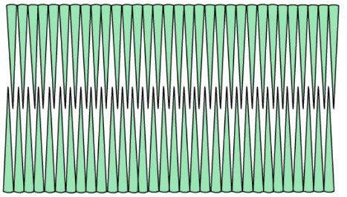
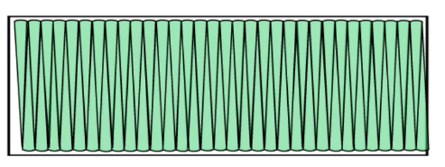
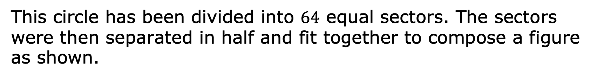
This circle has been divided into $64$ equal sectors. The sectors were then separated in half and fit together to compose a figure as shown.
volume 1, pg. 165

Slide 16
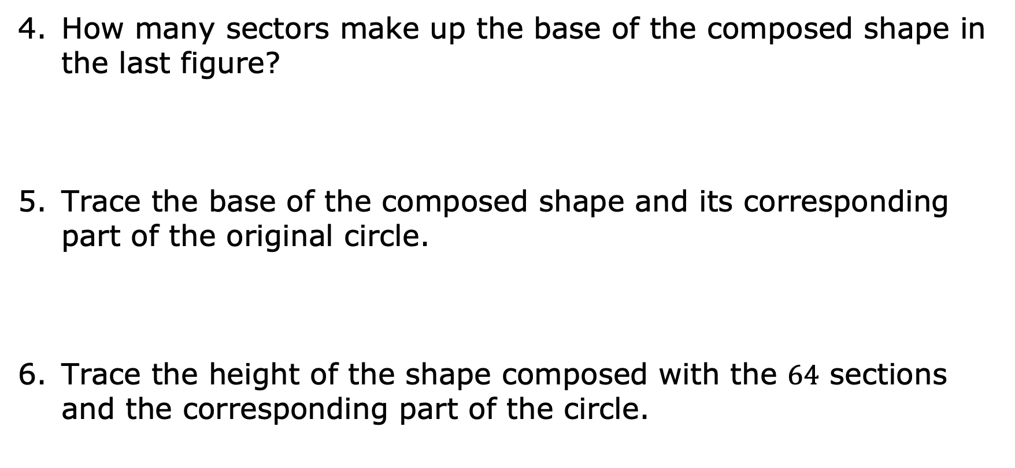
How many sectors make up the base of the composed shape in the last figure?
Trace the base of the composed shape and its corresponding part of the original circle.
Trace the height of the shape composed with the $64$ sections and the corresponding part of the circle.
volume 1, pg. 165

Slide 17
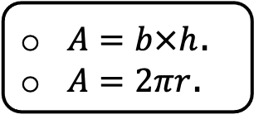
Complete the following statements.
The formula for the area of a rectangle is
The dimension of the circle that corresponds to one height of the rectangle is The dimension of the circle that corresponds to one base of the rectangle is
$A=b×h$.
$A=2πr$.
the radius.
half the circumference.
the radius.
half the circumference.
volume 1, pg. 165

Slide 18
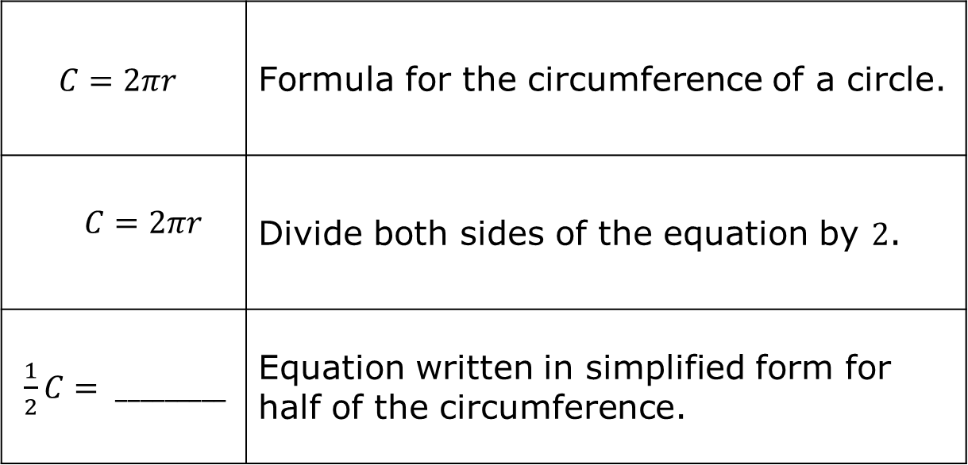
Given the formula $C=2πr$, work with your partner to find the measure of half the distance around a circle.
$$C=2πr$$ | Formula for the circumference of a circle.
$$C=2πr$$ | Divide both sides of the equation by $2$.
$\frac{1}{2}C= _________$ | Equation written in simplified form for half of the circumference.
volume 1, pg. 165

Slide 19
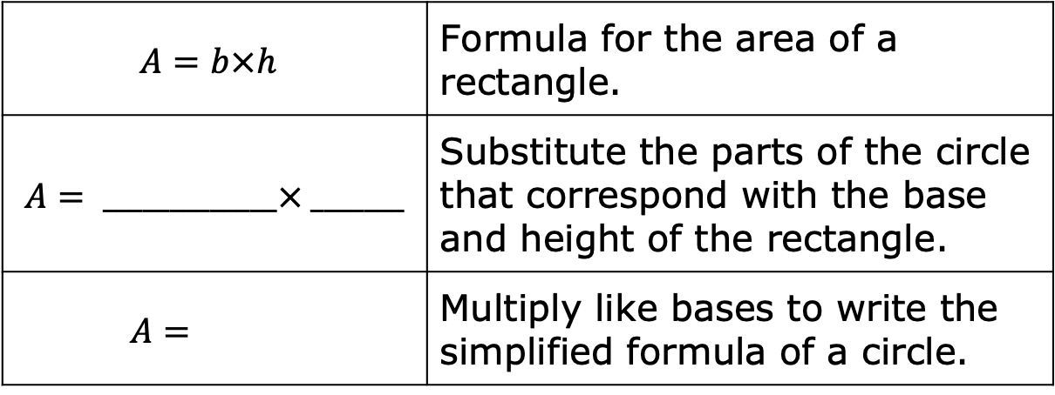
Given the formula for the area of a rectangle, substitute the corresponding parts of the circle to discover the area of a circle.
$$A=b×h$$ | Formula for the area of a rectangle.
$$A= _____________× _______$$ | Substitute the parts of the circle that correspond with the base and height of the rectangle.
$$A=$$ | Multiply like bases to write the simplified formula of a circle.
volume 1, pg. 166

Slide 20

Bring It Together
volume 1, pg. 166

Slide 21
4.8.4 Bring It Together: Area of a Circle
Use the words or phrases from the box to complete the sentences.
The formula for the area of a _________________ was used to discover the area of a ____________. When a circle is divided into sectors, the sectors can be arranged into a rectangle.
height | rectangle | half of the circumference
circle | radius | sector | circumference
volume 1, pg. 166

Slide 22
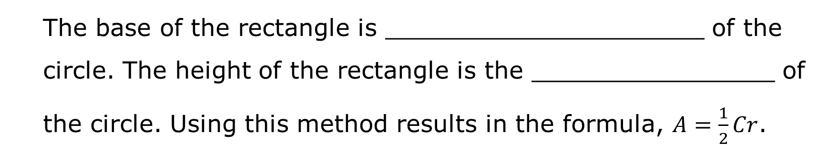
The base of the rectangle is _____________________ of the circle. The height of the rectangle is the ________________ of the circle. Using this method results in the formula, $A=\frac{1}{2}Cr$.
volume 1, pg. 166

Slide 23

Wrap-Up
volume 1, pg. 167

Slide 24
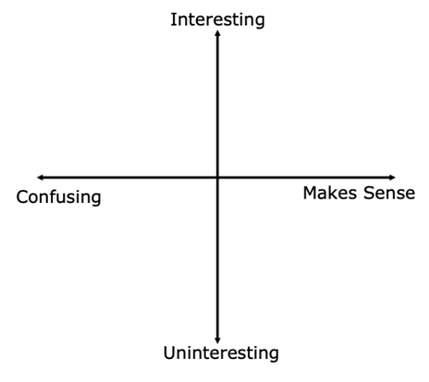
4.8.5 Wrap-Up: Reflection
Plot a point on the grid below to indicate your level of interest in today’s learning target and how much it made sense to you.
I can use the area of the rectangle to develop the formula for the area of a circle.
volume 1, pg. 167

